Slide 1
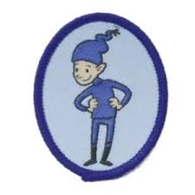
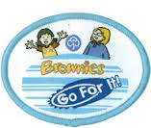
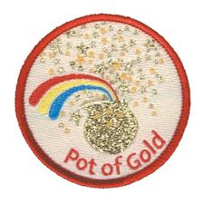
How much do you know about Brownies?
What is the name of this interest badge?
7. Brownies is part of a global family called WAGGGS. What does WAGGGS stand for?
2. What is the missing word? A Brownie Guide thinks of others before herself and does a good ______ everyday.
8. What year did Agnes Baden-Powell help her brother start Guiding?
9. On what day do Brownies celebrate World Thinking Day?
3. If a leader stands still and holds up their right hand what should you do?
10. How many years old are Brownies?
4. What do Brownies do at a Pow Wow?
11. What colour is a Brownie promise badge?
5. Which six badge is this?
12. When do you work towards this badge?
6. What do you get this badge for?

Slide 2
100 years of Brownies Quiz
1. How old do you have to be to join Brownies?
9. Who became the World Chef Guide in 1918?
2. What year did Guides officially start?
10. What is celebrated on the 22nd February each year?
3. Who is the founder of the Scouts, sometimes referred to as B-P?
11. How old do you have to be to become a Guide?
12. What organisation are all Guides across the world members of?
4. Who did B-P ask to start the Guides?
5. What year did Brownies start?
13. How many World Centres are there?
6. What was the original name for Brownies?
14. What badge can be worn by anyone who has made the Guide Promise?
7. What colour uniform did Brownies originally wear?
15. Name things that unite all Guides / Girl Scouts around the world.
8. What is the Brownie motto?

Slide 3
How much do you know about Brownies?
Artist
Turn
Stop and listen, put up your hand
Make plans / discuss things
Elf
They were a Rainbow Guide
World Association of Girl Guides and Girl Scouts
1910
22nd February
100
Yellow
Go For It Guides
100 Years of Brownies Quiz
7
1910
Baden-Powell
Agnes Baden-Powell
1914
Rosebuds
Blue
Lend a hand
Olive Baden-Powell
Thinking Day
10
WAGGGS
4
World Badge
The three part promise, fun, adventure (give marks as you see fit)

Slide 4
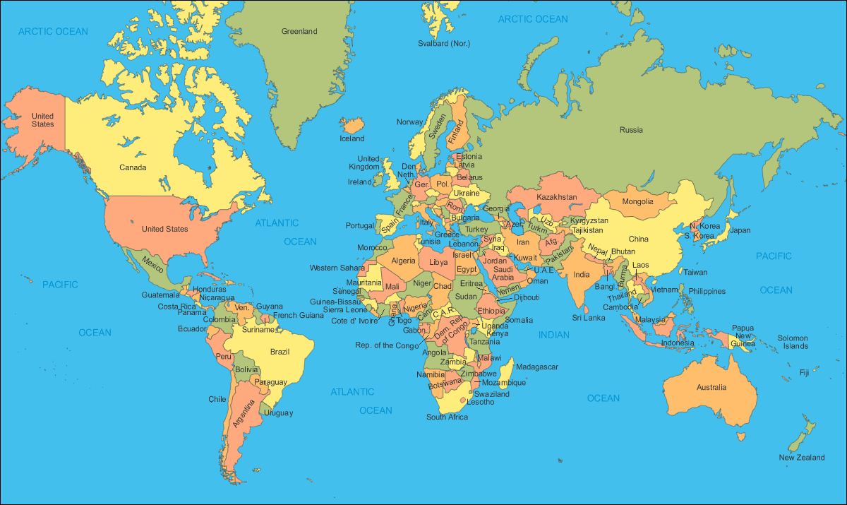
Where in the world?
Iceland
New Zealand
Canada
USA
China
Australia
Brazil
South Africa
Russia
Kenya

Slide 5
Where in the world? - ANSWERS
Iceland
Canada
Russia
USA
China
Kenya
Brazil
Australia
South Africa
New Zealand

Slide 6
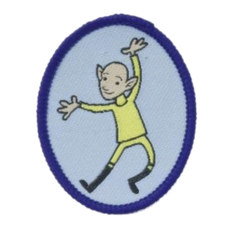
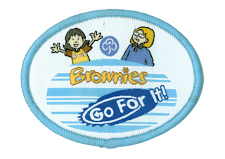
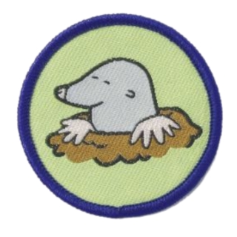
Brownie Badge Quiz
1.
2.
3.
4.
5.
6.
7.
8.
9.
10.
11.
12.

Slide 7
Brownie Badge Quiz
Cook
Brownie Adventure
Imp
Go For It Guides
First Aid
Brownie Buddy
Collector
Mole
Brownie Promise Badge
World Badge
Agility
Pot of Gold

