Slide 1
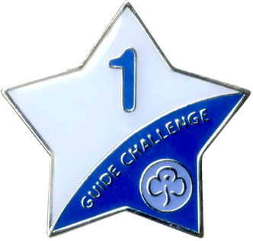
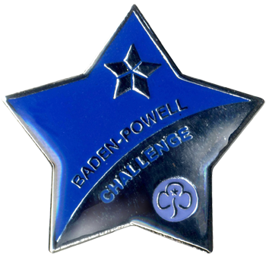
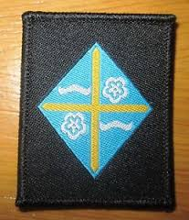
Guide Badge Quiz
1.
2.
3.
4.
5.
6.
7.
8.
9.
10.
11.
12.

Slide 2
Guide Badge Quiz
Chocolate
Year 1 Challenge
Guide Camp Permit
Commonwealth Award
Circus Skill
Go For It Parties
Baden Powell Award
Animal Active
Go For It Peace
World Badge
Guide Promise Badge
Cleveland County

Slide 3
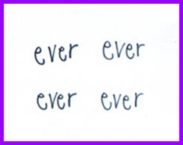
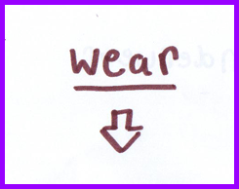
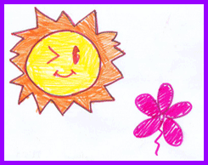
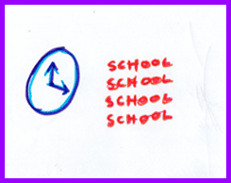
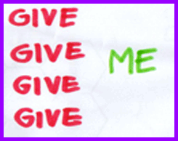
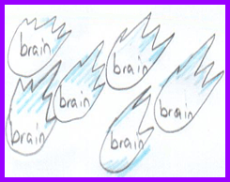
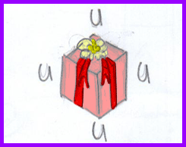
Dingbats!
1
2
3
4
6
7
8
9
10

Slide 4
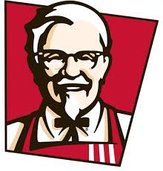
17
Logo Quiz
1
5
9
10
13
2
18
6
14
11
3
7
19
12
15
8
4
20
16

Slide 5
Dingbats
Forever
Underwear
Sunflower
Monkey
Time for School
Forgive me
Turn Around
Brain Storm
Forgive You
Logo Quiz
McDonalds
Red Bull
Chanel
UN
Morrisons
Apple
Nike
Facebook
Blackberry
Vodaphone
Citron
Windows
Pepsi
KFC
Converse
Barclays
Volkswagen
X-box
Twitter
Adidas

Slide 6
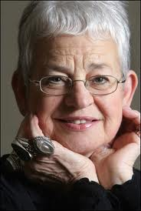
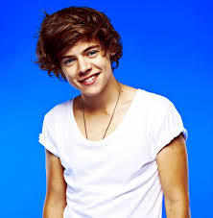
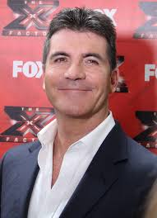
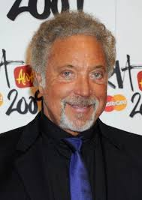
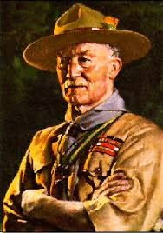
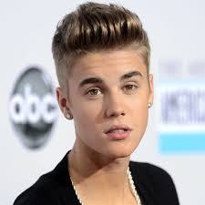
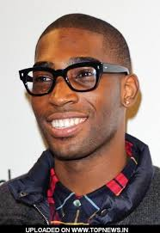
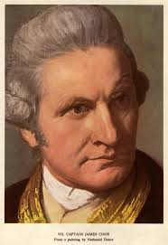
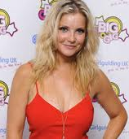
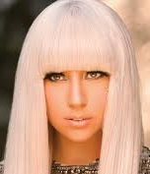
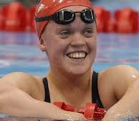
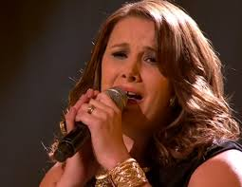
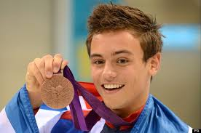
Who is this?
2
3
1
4
5
6
7
8
9
10
11
13
14
15
12

Slide 7
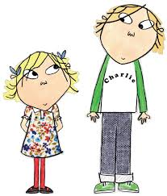
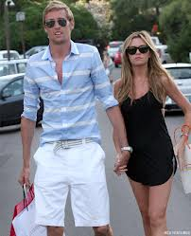
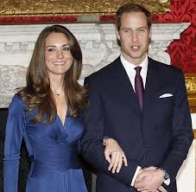
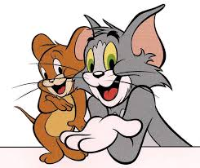
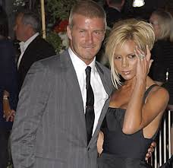
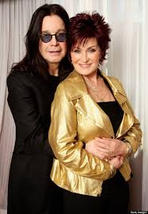
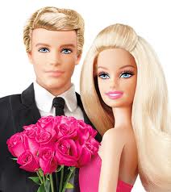
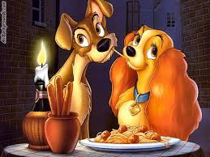
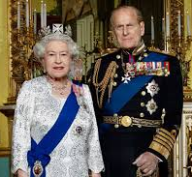
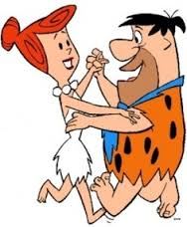
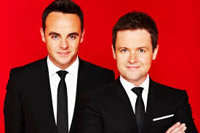
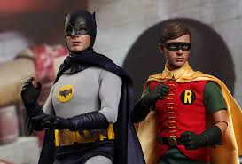
1
Name these famous duos!
4
2
3
5
6
7
8
9
11
12
10

Slide 8
Who is this?
Jacqueline Wilson
Harry Styles
Justin Beiber
Simon Cowell
Tom Jones
Baden-Powell
Tinie Tempah
Harry Potter
Captain James Cook
Helen Skelton
Bear Grylls
Ellie Simmons
Lady Gaga
Tom Daily
Sam Bailey
Famous Duos
Charlie and Lola
Prince William and Kate Middleton
Tom and Jerry
Abbey Clansy and Peter Crouch
David and Victoria Beckham
Sharon and Ozzie Osbourne
Barbie and Ken
Lady and the tramp
Queen Elizabeth II and Prince Philip
Fred and Wilma Flintstone
Batman and Robin
Ant and Dec

