Slide 1
Brownie World Guiding Badge Resource Pack
These resources have been made for our own unit to use to complete the World Guiding badge.
It doesn’t cover all the clauses but enough to earn the badge.
These are not official resources but you are free to use them in your own units.
You should consult the Brownie website for the badge syllabus.

Slide 2
Contents
Slide 3 – World Flags Game, girls can either work on their own or in a team. They have to find the flags hidden around the room and write the name of the country on their answer sheet.
Slide 7 – Information about Brownies in 4 different countries, Canada, Ireland (we picked this because we are joint Church of England and Roman Catholic unit which would not happen in Ireland), Kenya and New Zealand. The girls could use this to make their own posters / information booklets.
Slide 11 – The meanings of the world trefoil
Slide 12 – World trefoil beetle game score cards
Slide 13 – Images of the 4 world centres
Slide 17 – Learn facts about the world centres with this foldable fortune teller, just cut it out and fold.
Slide 18 – Doll outline which girls can use to decorate with uniforms.
Slide 19 – Selection of images to show different Brownie uniforms, most are taken from the WAGGGS site.
Slide 22 – Template for postcard

Slide 3
Canada
Mexico
France
Morocco
New Zealand
Turkey

Slide 4
Australia
China
Finland
Greece
South Africa
Romania

Slide 5
Pakistan
Japan
Poland
Kenya
Saudi Arabria
Italy

Slide 6
Name:
Find the flags hidden in your meeting place, write the country name next to each of the flags.

Slide 7
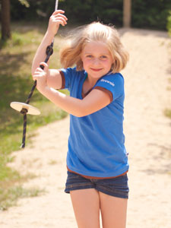
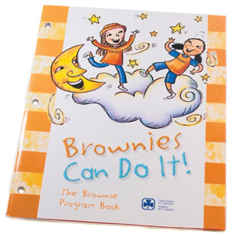
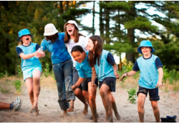
For girls ages 7 and 8. Brownie Units meet once a week, usually for an hour and a half.
Brownies have a book to follow called ‘Brownies can do it’
Some Canadian Brownies speak French as their first language.
CANADA
Brownie Promise
I promise to do my best,
To be true to myself, my beliefs and Canada,
I will take action for a better world,
And respect the Brownie Law
Brownie Law
As a Brownie I am honest and kind. I help take care of the world around me.
Brownie activities include:
Learning about healthy friendships
Community service projects
Celebrating different cultures
Finding out how to use basic tools, like screwdrivers and hammers
Planning menus for healthy eating
Visiting an artist's studio
Planting an edible garden
Learning how to build and light a fire

Slide 8
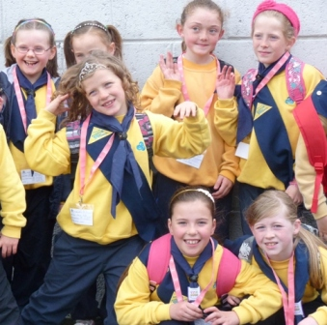
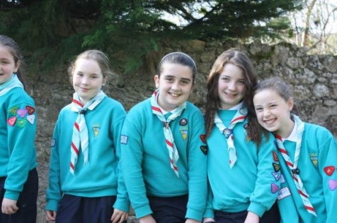
IRELAND
Age Range: 6½ - 11 yrs
Promise: "I promise to do my best, to do my duty to my God* and my country, to help those at home everyday, and to obey the Brownie Guide Law".
*The word "God" can be replaced by the word "faith" according to one's spiritual beliefs.
When a Brownie Guide makes her promise she holds up 3 fingers of the right hand, keeping the thumb and little finger bent so that they touch.
Motto: "Lend a Hand"
Handshake: Brownie Guides may use the left handshake, in common with all members of the Guide and Scout movement worldwide.
Uniform: Brownie Guides wear a yellow sweatshirt and/or polo shirt with the IGG logo, a navy neckerchief with black woggle, Brownie Guide sash, navy tracksuit bottoms and runners.
Catholic Guides
Some girls join Catholic units, and they are called Brigini not Brownies.

Slide 9
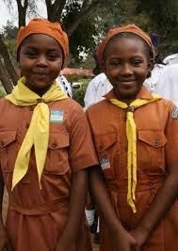
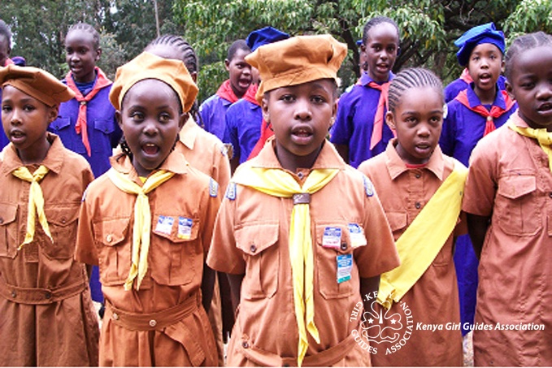
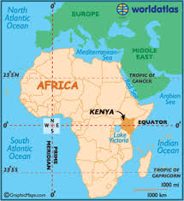
KENYA
Brownies are aged 7 to 11 years.
Brownie Promise
I promise to do my best: To do my duty to God and my Country, To help other people every day, and To keep the Brownie Law.
Brownie Law
A Brownie is truthful, obedient and cheerful. A Brownie thinks of others before herself
Brownie Motto - Lend a Hand
What do Brownies in Kenya do?
Earn badges
Play games
Enjoy crafts
Learn about keeping safe and healthy
Have fun
Raise money for charity
Enjoy singing and the outdoors

Slide 10
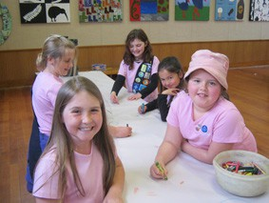
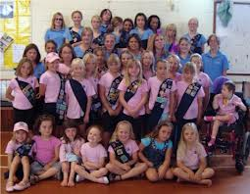
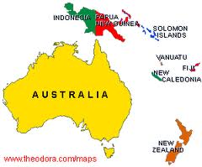
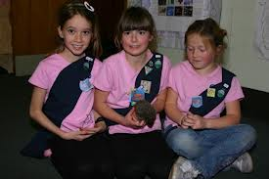
NEW ZEALAND
Brownies are 7 - 9½ year old girls.
Brownie work in sixes with a sixer and second.
Brownies work for badges and certificates.
Brownies have a special celebration when they make their promise and get a silver coloured pin badge.
Brownies enjoy craft, games, outdoors and going on trips and holidays.
Brownies enjoy ‘revels’ where they meet up with other Brownies from other units.
Brownie Laws As a Guide, I will try to:
be honest and trustworthy
be friendly and cheerful
be a good team member
be responsible for what I say and do
respect and help other people
use my time and abilities wisely
face challenges and learn from experiences
and care for the environment
Brownie Promise
I promise, with the help of my God, to be true to myself, to do my best to help my country and to live by the Guide Law.

Slide 11
What do the parts of the world badge mean?
The 3 leaves show the 3 parts of our promise.
The yellow outer is to show the sun shining on the children of the world.
The needle is like in a compass and it points the way forward.
The flame show the love of human’s everywhere
The 2 stars are for the Promise and the Law.

Slide 12
World Flag Beetle
World Flag Beetle
Roll a …
6 for the blue sky
5 for the gold sun
4 for the flame
3 for the trefoil leaves
2 for the stars
1 for the needle
Roll a …
6 for the blue sky
5 for the gold sun
4 for the flame
3 for the trefoil leaves
2 for the stars
1 for the needle

Slide 13
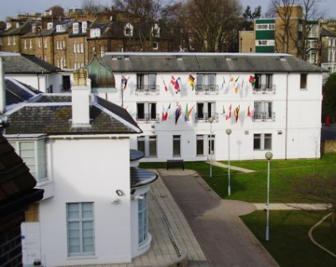
Pax Lodge
London

Slide 14
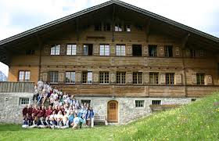
Our Chalet - Switzerland

Slide 15
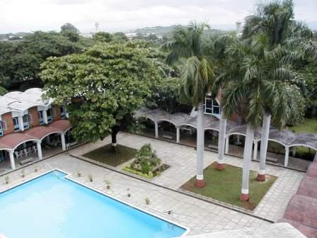
Sangam - India

Slide 16
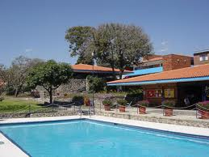
Our Cabana - Mexico

Slide 17
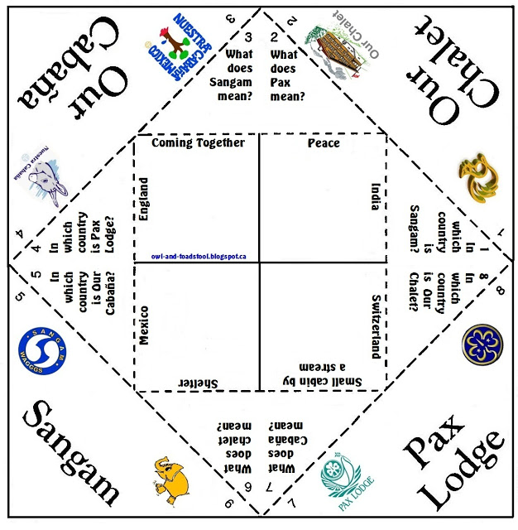

Slide 19
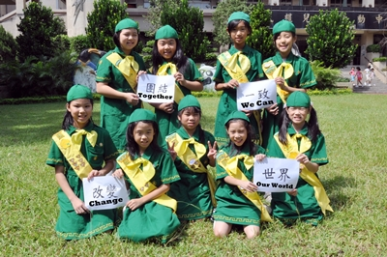
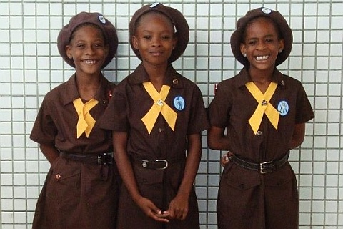
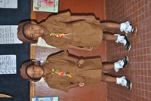
Taiwan
Barbados
Ghana
Ireland
Canada

Slide 20
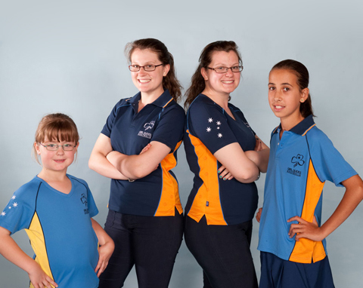
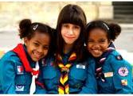
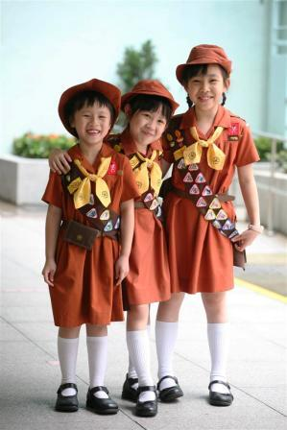
Malta
Australia
Kenya
Cyprus
New Zealand
Hong Kong

Slide 21
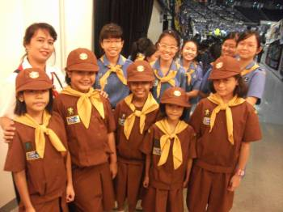
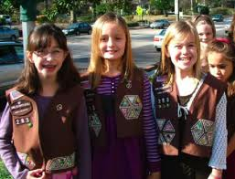
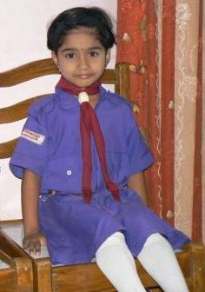
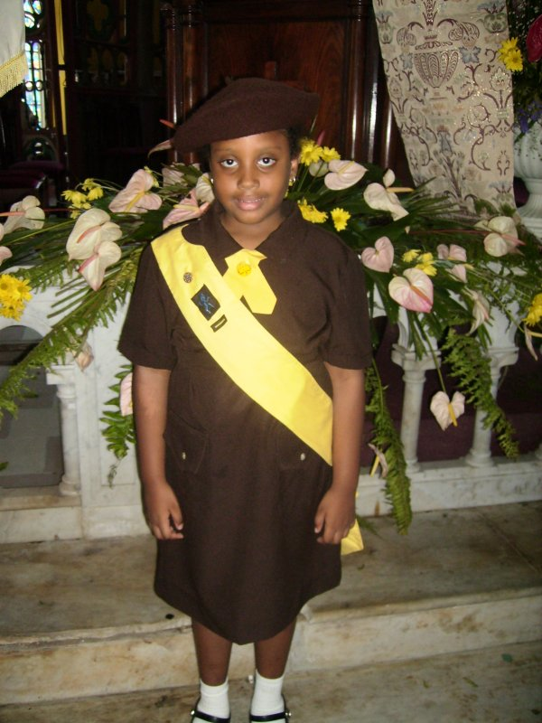
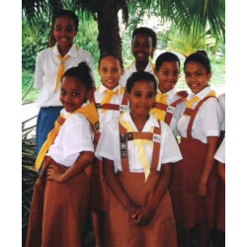
Singapore
USA
Bharat - India
St Lucia
South Africa

