Slide 1
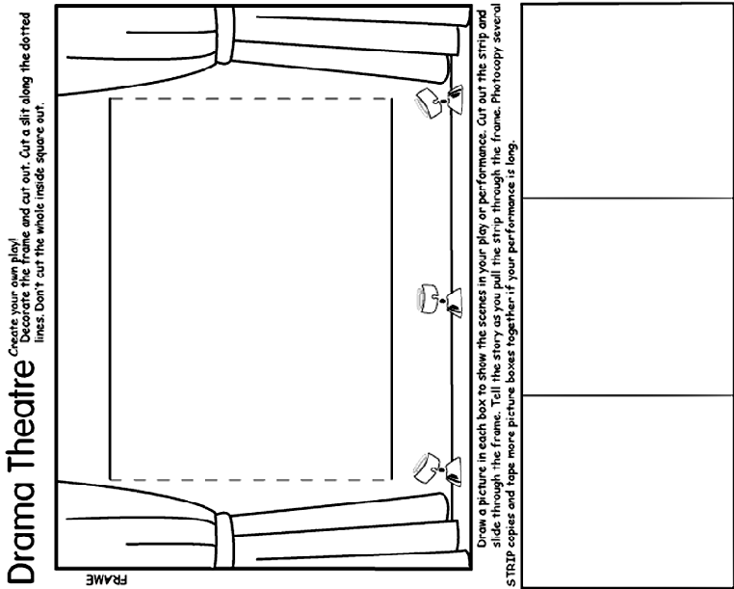

Slide 2
You are going to make up a short play. You need to include the four things you have been given along with the prop.
All girls in your six need to take part.
You are going to make up a short play. You need to include the four things you have been given along with the prop.
All girls in your six need to take part.
You are going to make up a short play. You need to include the four things you have been given along with the prop.
All girls in your six need to take part.
You are going to make up a short play. You need to include the four things you have been given along with the prop.
All girls in your six need to take part.

Slide 3
Grandma | Baby | Doctor | Mummy
School | Garden | Shops | Home
First Aid | Cooking | Sewing | Map Reading
Anger | Happiness | Excitement | Kindness
Notes:
Red = Person, Green = Situation, Purple = Brownie Skill, Black = Emotion. These are picked at random for each six. You will need to add more if you have more than 4 sixes.

Slide 4
Cow | Cat | Sheep | Pig
Cow | Cat | Sheep | Pig
Horse | Dog | Duck | Owl
Horse | Dog | Duck | Owl
Hen | Mouse | Rabbit | Goat
Hen | Mouse | Rabbit | Goat
Notes:
Hand out the animal cards, girls have to find their partner using noises and actions. They can’t speak words.

Slide 5
Book
Reading
Booklover
Rider
Horse
Stables
Cycle
Bike
Cyclist
Circus
Juggling
Clown
Dancer
Dance
Music
Map
Signpost
Finding your way
Cook
Food
Oven
Camper
Camping
Tent
Notes:
Hand out the badge images, Brownies then act out / describe the badge. They are not allowed to say certain words

Slide 6
Craft
Glue
Make
Writing
Writer
Pen
Fire
Safety
Flames
Toymaker
Toy
Puppet
Sports
PE
Running
Swimming
Swimmer
Pool
Musician
Music
Play
Road Safety
Green Cross Code
Safety
Notes:
Hand out the badge images, Brownies then act out / describe the badge. They are not allowed to say certain words

Slide 7
Wildlife Explorer
Butterfly
Ladybird
Agility
Balance
Catch
World Traveller
Passport
Journey
Artist
Paint
Picture
Computer
Games
Mouse
World Guiding
Global
Brownies
Hostess
Party
Coffee
First Aid
Bandage
Cut
Notes:
Hand out the badge images, Brownies then act out / describe the badge. They are not allowed to say certain words

Slide 8
You watching a football team and your team has just scored the winning goal.
You are standing on the harbour, watching your family and friends leave on a boat. You are never going to see them again.
You are meeting the Queen to have an award presented to one of your group.
You are on safari and there is a group of lions in front of you.
Notes:
Each six (change the logo if you wish), makes a freeze frame to show their given situation. The other groups have to work out what they are showing.

Slide 9
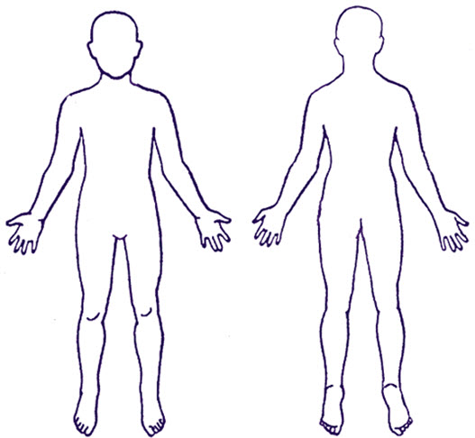
Use the two outlines to show your costume design for your character.
Name of Character

Slide 10
Cut out these characters on card. Stick them onto bamboo skewers and then you can use them to put on a show!

Slide 11
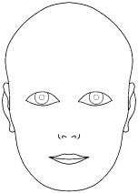
Use these faces to show what make up and hair style your character would have.

