Slide 1
Brownie Booklover Badge
Name: ______________________

Slide 2
What I need to do
Use this check list to make sure you have covered everything for your badge, you can colour the smiliy face when you have done it.
Return all the sheets and anything you have made to your Brownie leader to be awarded with your badge. Enjoy and have fun!
1. Use the Brownie Book Record to make a list of at least 4 books that you have enjoyed .
4. Make a bookmark for a friend
2. Read 2 books by two different authors and complete the book reviews.
5. Use your Brownie Adventures Book to complete the quiz sheet.
3. Complete the care for a book sheet.
6. Complete the library fact sheet.
You can download the full syllabus for the Booklover badge at www.girlguiding.org.uk/brownies

Slide 3
My Brownie Reading Record
Title of Book: Rating
Author:
Title of Book: Rating
Author:
Title of Book: Rating
Author:
Title of Book: Rating
Author:
Title of Book: Rating
Author:

Slide 4
Brownie Book Review
What happened in the book?
Book Title
Author
Colour the stars to give it a rating
What was the best bit of the book?
Would you recommend this book? Yes / No
Why?

Slide 5
Brownie Book Review
What happened in the book?
Book Title
Author
Colour the stars to give it a rating
What was the best bit of the book?
Would you recommend this book? Yes / No
Why?

Slide 6
Caring for books!
Quiz
Put a circle around the things that are good for books and a cross through things that shouldn’t be around book.
Use the index of your Brownie Adventure book to find the answers.
Go For It Badge – Where can you wear this?
Sun Safety – What should you slop on?
Water Saving – what should you do with taps when cleaning your teeth?
Number Fun Badge – how much do you have to redesign your bedroom?
Quiet sign – Which hand does a leader raise?
Designer badge – What can you make a stamp using?

Slide 7
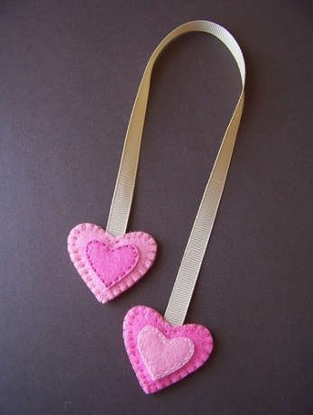
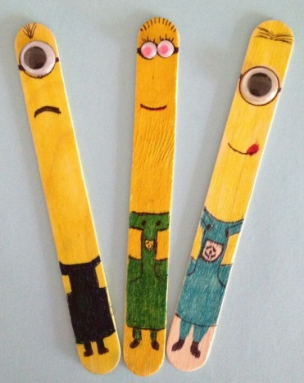
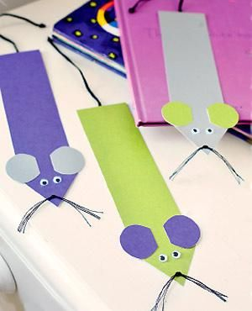
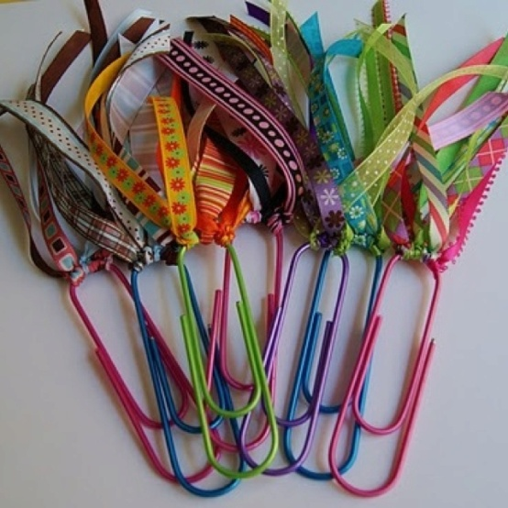
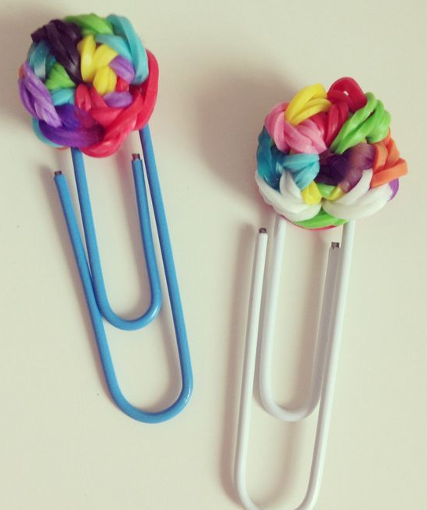
A bookmark for a friend
You could colour, decorate and cut out one of these bookmarks. You can stick them onto card to make them more hardwearing. Or you can use your creative skills to make your own bookmark. These pictures might give you some ideas.

Slide 8
Library Fact File
Find out about your local library and complete this fact file, the best way to do this is to visit the library or you could do it using the internet.
My local library is…
Draw pictures or write about what you can borrow or use in your local library.
Its opening hours are
Monday
Tuesday
Wednesday
Thursday
Friday
Saturday
Sunday

